Slide 1
Economic Update Hello Addison County! Nov 2021
Mathew Barewicz
Economic & Labor Market Information Division
Vermont Department of Labor
802.828.4153
Mathew.Barewicz@vermont.gov

Slide 2
Economic & Labor Market Information Division Online at VTLMI.info
Housed in the Vermont Department of Labor
State partner to the Federal Government
100% federally funded
Thank you to the USDOL Employment & Training Administration!
Purpose: to produce, explain and disseminate economic data for the benefit of the State of Vermont, educational institutes, employers, students, job-seekers, researchers, and the general public.

Slide 3
MOMENT OF APPRECITION
Thank you all for the work you do!!

Slide 4
DISCLAIMER
My opinions and my opinions alone…
…data wise, the pandemic hit at the worst possible time --- early 2020

Slide 5
2020 Census – Partial Results
We thought for a decade… ~626k
Turns out we were climbing to… +643k!!!

Slide 6
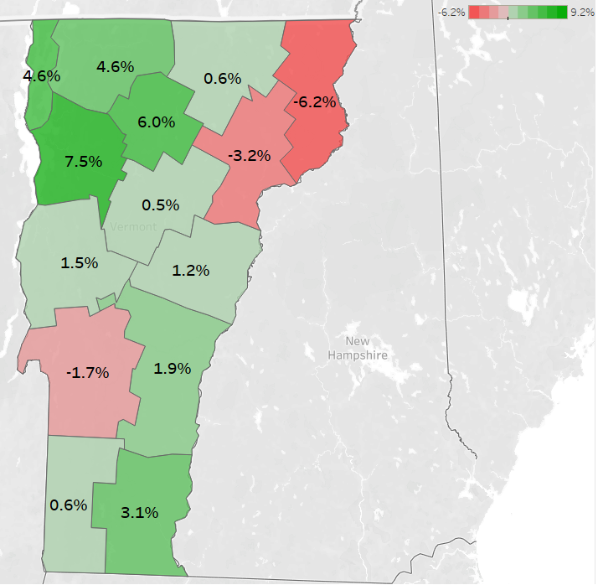
2020 Census – Partial Results Addison County pop of 37,363 (+1.5% or +542 since 2010)

Slide 7
The “Great Recession” of 2007

Slide 9
The COVID-19 Recession

Slide 10
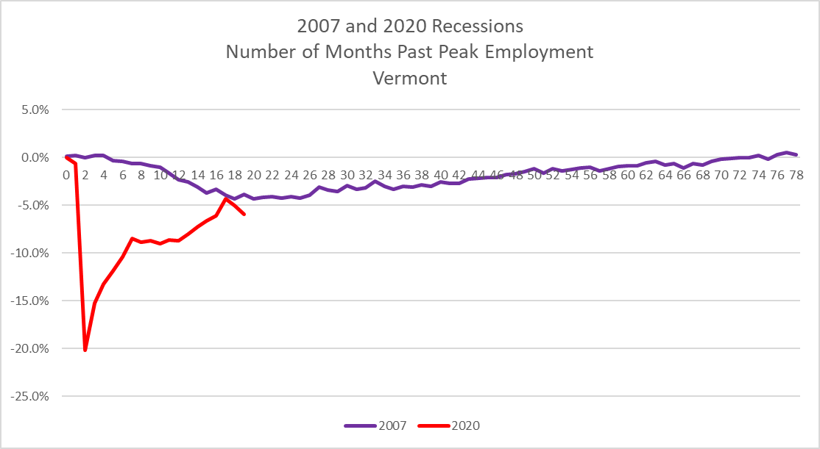
What will recovery look like?
Reader Guidance – 5% equals about 15,000 jobs
Jobs <> People… but close
Does not include structural job loss

Slide 11
The COVID-19 Recession – Sub-State
Represents a count of filled jobs; unfilled jobs not tracked here.

Slide 12
The COVID-19 Recession – Industry of Note
Represents a count of filled jobs; unfilled jobs not tracked here.

Slide 13
The COVID-19 Recession – Industry of Note
Represents a count of filled jobs; unfilled jobs not tracked here.

Slide 14
The COVID-19 Recession – Industry of Note
Represents a count of filled jobs; unfilled jobs not tracked here.

Slide 15
The COVID-19 Recession – Industry of Note
Represents a count of filled jobs; unfilled jobs not tracked here.

Slide 16
The COVID-19 Recession – Industry of Note
Represents a count of filled jobs; unfilled jobs not tracked here.

Slide 17
Local Area Unemployment Statistics (LAUS)
Bureau of Labor Statistics program
Major input into the LAUS model is data from the monthly Current Employment Survey (CPS)
The CPS is administered monthly by the US Census Bureau
The CPS is a “managed panel” survey – 1,200 Vermont households
Both the CPS and LAUS use the same definitions
Labor force…
Unemployed…

Slide 20
Labor Force Metrics – Addison County
Relatively stable labor force
Sept 2021: 20,127
Sept 2019: 20,569
Change of -442 or -2.1%
With half the number of unemployed
Sept 2021: 266 (rate of 1.3%)
Sept 2019: 473 (rate of 2.3%)
Change of -207 or -43.8%

Slide 21
Labor Force Composition - Gender
Dubbed the “She”-cession
Women disproportionately impacted
Hardest hit industries
Disruptions to childcare and education
What does recovery look like for this population?

Slide 22
Labor Force Composition - Race
The growing population cohorts are non-white
Particularly among youth
The future of VT’s labor force will be greater racial and ethnic diversity

Slide 23
Labor Force Composition - Age
The earliest Baby-Boomers are turning 75 in 2021
Youth labor force participation rate has dropped!
16-19 LFPR
mid-2000s ~60%;
pre-COVID ~45%;
now below 40%

Slide 24
*Version 4*
A Continued Partnership with the McClure Foundation
Highlighting E&LMI Data
Found online:
VTLMI.info
in the upper right
OR McClureVT.org

Slide 25
<<< New This Edition
Found online:
VTLMI.info
in the upper right
OR
McClureVT.org

Slide 26
Conclusions
The “skills of yesterday” are the “skills of today”
Many of which will continue to be the “skills of tomorrow”
Show up on time
Work well with others
Follow instructions
More information leads to better decisions
VTLMI.info has a wealth of free information

Slide 27
Thank you! Provide feedback at VTLMI.info
Mathew Barewicz
Economic & Labor Market Information Division
Vermont Department of Labor
802.828.4153
Mathew.Barewicz@vermont.gov

